Slide 1
AIM
Inleiding
OOSE-OOAD

Slide 2
Doelstelling en inhoud
OOSE-OOAD

Slide 3
Programming is fun, but …
“Programming is fun, but developing quality software is hard.
In between the nice ideas, the requirements or the 'vision', and a working software product, there is much more than programming.
Analysis and design -- defining how to solve the problem, what to program, capturing this design in ways that are easy to communicate, to review, to implement, and to evolve …”
Philippe Kruchten

Slide 4
Doel en inhoud van course OOAD (1)
Analyseren en ontwerpen van een OO applicatie met behulp van notatietechnieken uit UML (Unified Modeling Language). Voorbeelden van UML-(diagram)technieken die aan de orde komen:
use cases
class diagrams
sequence diagrams
activity diagrams

Slide 5
Doel en inhoud van course OOAD (2)
Functionele en niet-functionele requirements
Vertalen van OO ontwerp naar initiële Java-code
Objectgeoriënteerde ontwerpprincipes
GRASP (Low coupling, High cohesion, …)
SOLID (Single Responsibility, Open/Closed, Dependency Inversion, …)
OO Design Patterns
Verantwoorden van ontwerpbeslissingen, alternatieve oplossingen afwegen.

Slide 6
Studiemateriaal
Larman, Craig. Applying UML and Patterns: An Introduction to Object-Oriented Analysis and Design and Iterative Development, Prentice Hall, 3rd edition, ISBN: 0131489062
Studiehandleiding course OOAD (zie Onderwijs Online)
Werkboek course OOAD (zie Onderwijs Online)
Sheets (zie Onderwijs Online)
Software:
Astah Professional / PlantUML

Slide 7
Toetsing
Schriftelijke toets UML (eind week 4)
Schriftelijke toets OO Design (week 7)
Case study OOAD (week 4 t/m 8)
Zie studiehandleiding en OWE-beschrijving voor details

Slide 8
UML

Slide 9
Wat is UML?
Visuele taal om objectgeoriënteerde analyses en ontwerpen voor software te kunnen maken
UML is géén methode
Standaardiseert dus geen werkwijze!
UML standaardiseert begrippen en diagrammen
De diagrammen samen vormen een model van het software systeem
Combinatie van concepten op gebied van:
Gegevensmodellering (ER-achtig)
Bedrijfsmodellering (workflow)
Object modellering
Componenten modellering

Slide 10
UML-technieken en -diagrammen
Behavior
Use cases, Use Case diagram
State machine diagrams
Activity diagrams
Interaction
Sequence diagrams
Communication diagrams
Structure
Class diagrams
Package diagrams
Object diagrams
Component diagrams
Deployment diagrams

Slide 11
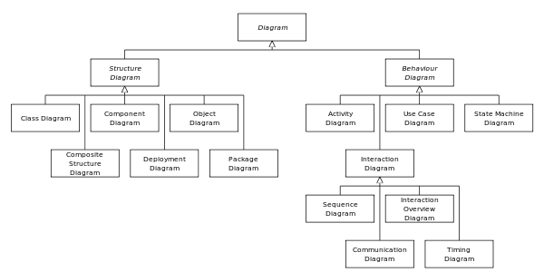
UML-diagrammen

Slide 12
Use Case Diagram
NextGen
Process Sale
<< system >>
Payment
Cashier
Authorization Service
Handle Returns
<< system >>
Process Rental
Tax Calculator
<< system >>
Cash In
Accounting
System
System
Manage Security
Administrator
Manage Users

Slide 13
Use Case (1)
Primary actor: Cashier
Stakeholders and interests: Cashier, Customer, Company, etc.
Preconditions: Cashier is identified and authenticated
Postconditions (Success Guarantee): Sale is saved. Tax is correctly calculated. Etc.
Main Success Scenario
Actor action | System responsibility
1. Customer arrives at a POS checkout with goods to purchase.
2. Cashier starts a new sale.
3. Cashier enters item identifier | 4. System records each sale line item and presents item description and running total. Price calculated from a set of price rules.
Cashier repeats steps 3-4 until indicates done. | 5. System presents total with taxes calculated.
6. Cashier tells Customer the total, and asks for payment.
7. Customer pays. | 8. System handles payment.
 | 9. System logs the completed sale and sends information to external accounting and inventory systems. System presents receipt.
………

Slide 14
Use Case (2)
Extensions (Alternative flows):
Actor action | System responsibility
 | 3a. [Invalid identifier] 1. System signals error and rejects entry.
3-6b. [Customer tells Cashier to cancel sale] 1. Cashier cancels Sale on system
7a. [Paying by cash] 1.Cashier enters the cash amount tendered. 2. System presents the balance due, and releases the cash drawer. 3. Cashier deposits cash tendered and returns balance in cash to Customer. 4. Systems records the cash payment.
7b. [Paying by credit] ……………

Slide 15
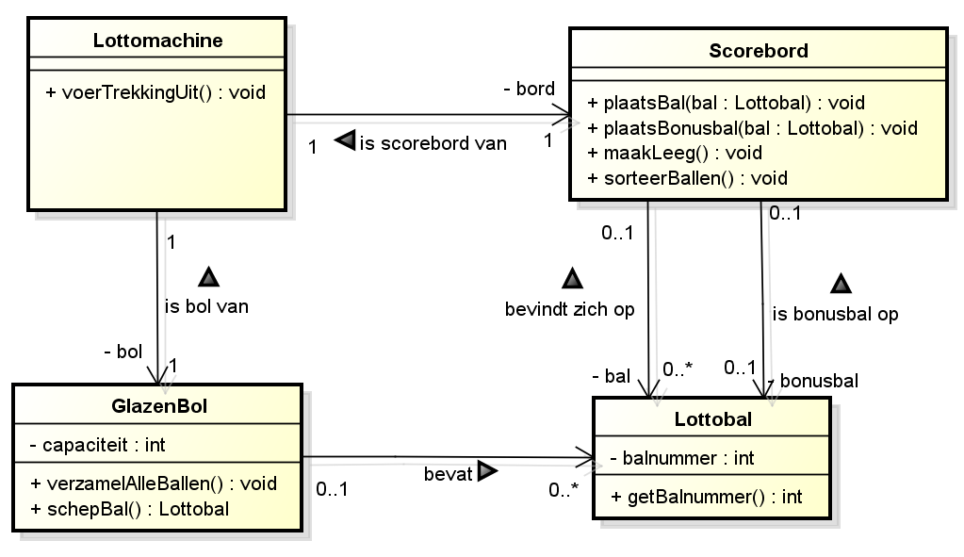
Class Diagram

Slide 16
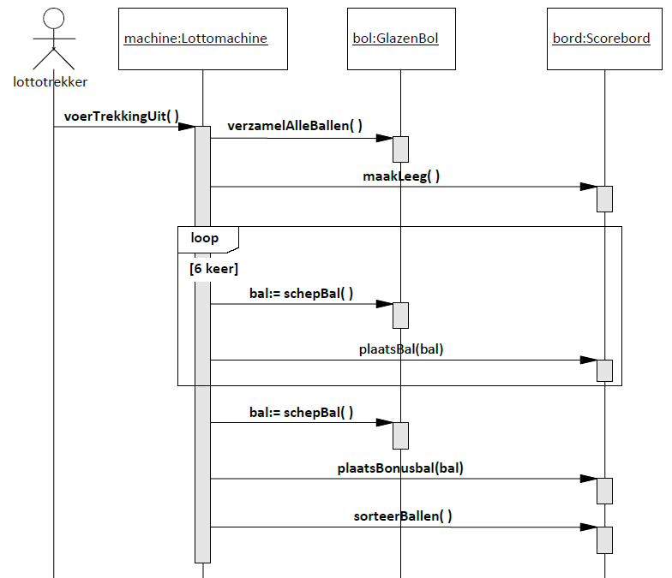
Sequence diagram

Slide 17
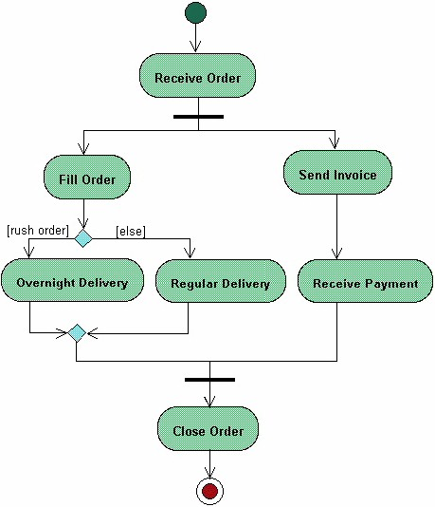
Activity diagram

Slide 18
OO Analysis and Design
Voorbeeld Dice Game

Slide 19
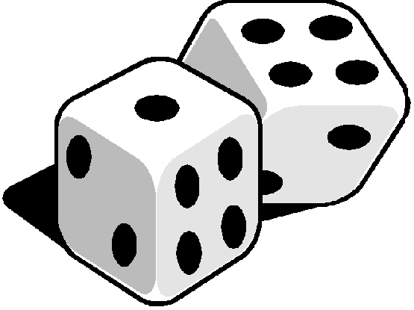
Use Case
Play a Dice Game:
Player requests to roll the dice. System presents results: If the dice value totals seven, player wins; otherwise, player loses.

Slide 20
Domain Model
Player
Die
1
Rolls
2
name
faceValue
1
2
Plays
1
DiceGame
1
Includes

Slide 21
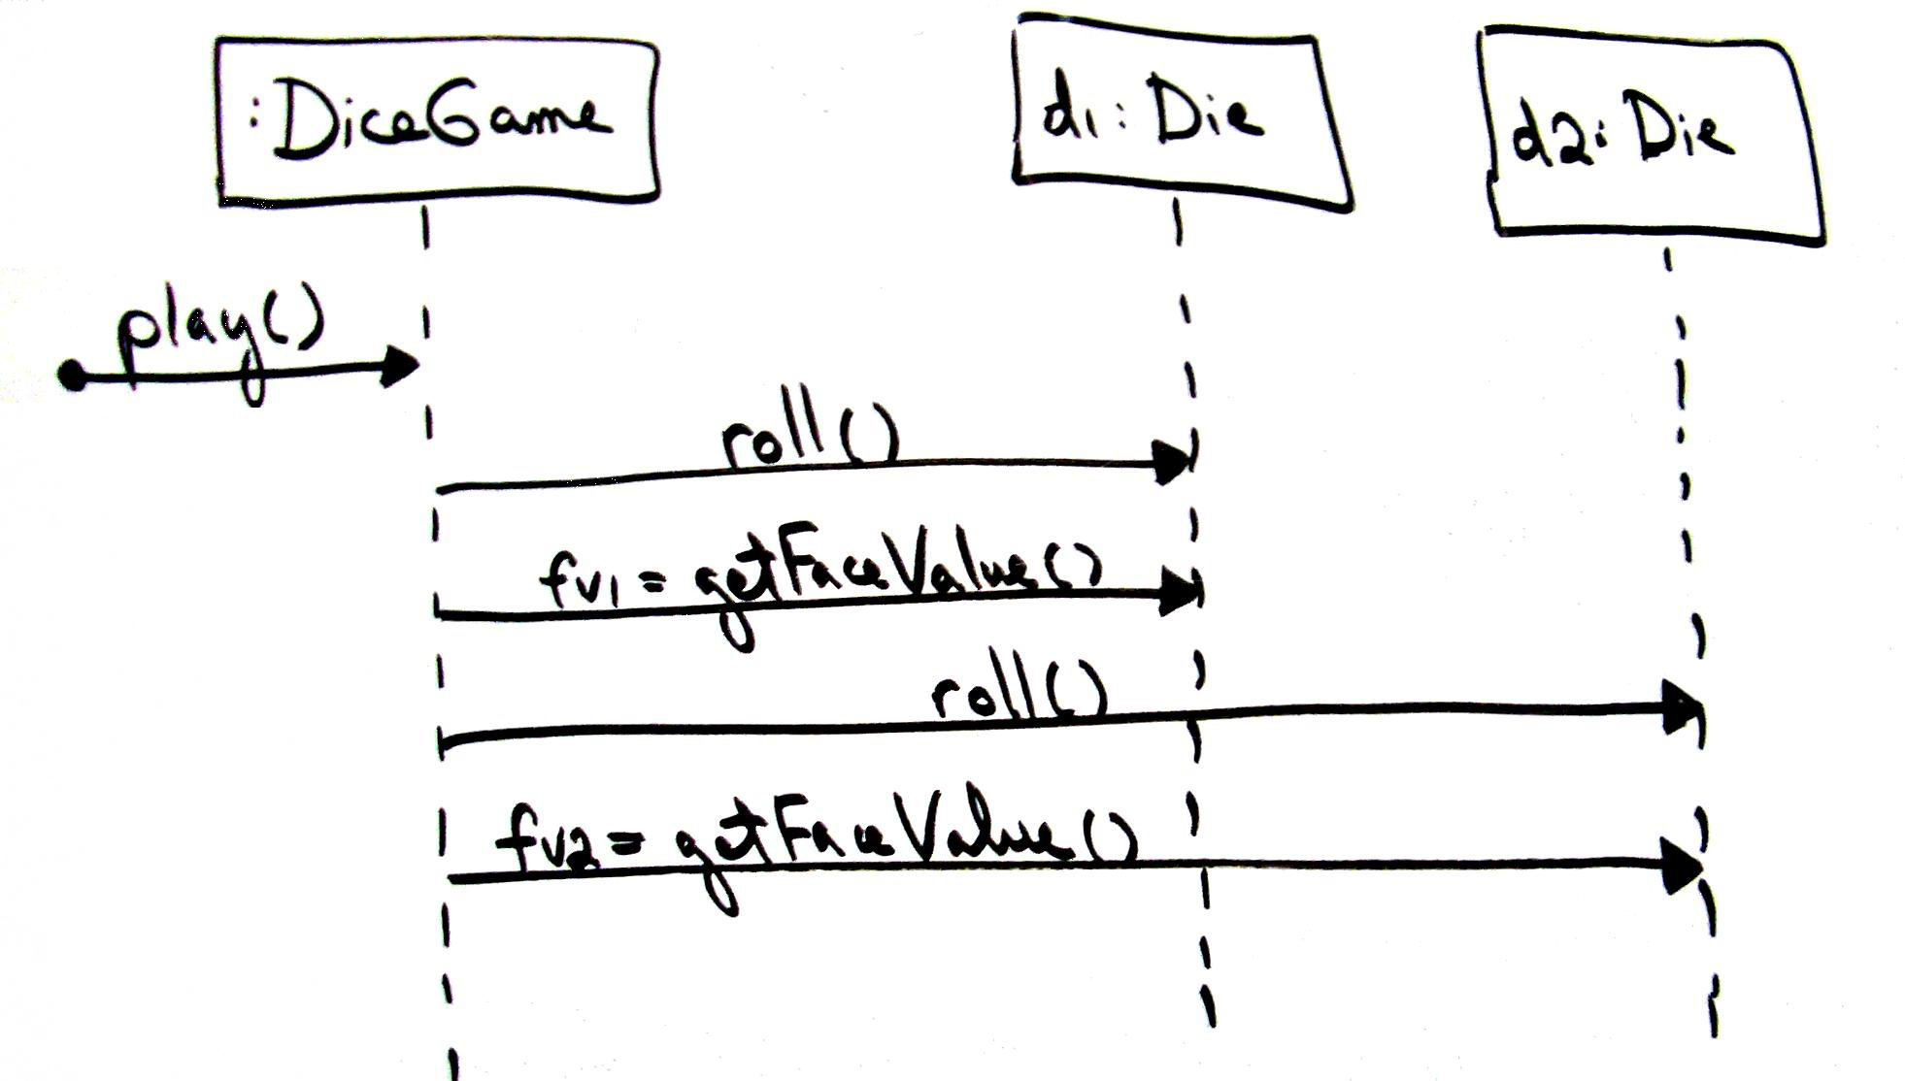
Sequence Diagram voor play()

Slide 22
Design Class Diagram
DiceGame
Die
1
2
faceValue
:
int
play
()
getFaceValue
() :
int
roll
()

Slide 23
Java-code
public class DiceGame {
private Die[] dice;
public void play() {
// TO DO: implement
}
}
public class Die {
private int faceValue;
public int getFaceValue() {
// TO DO: implement
}
public void roll() {
// TO DO: implement
}
}

Slide 24
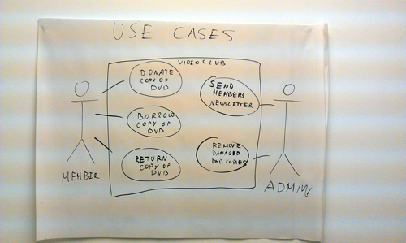
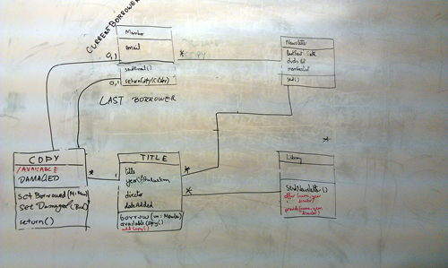
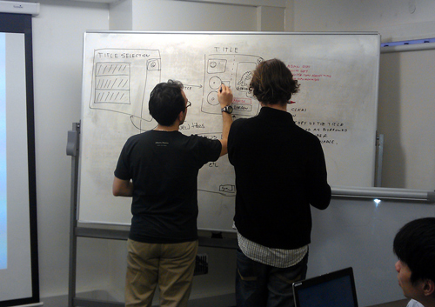
Uit de praktijk
Notes:
Wat valt op? Teams; Overleg voor whiteboard; Zitten niet individueel achter toetsenbord

